Slide 1
GRAPHS

Slide 2
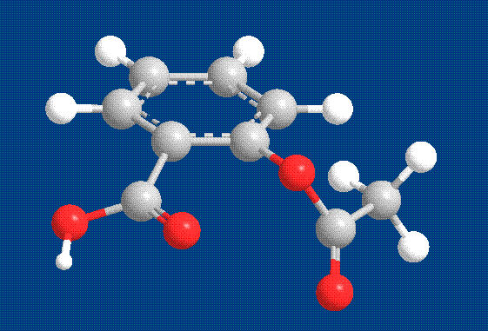
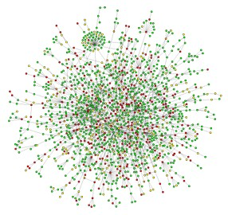
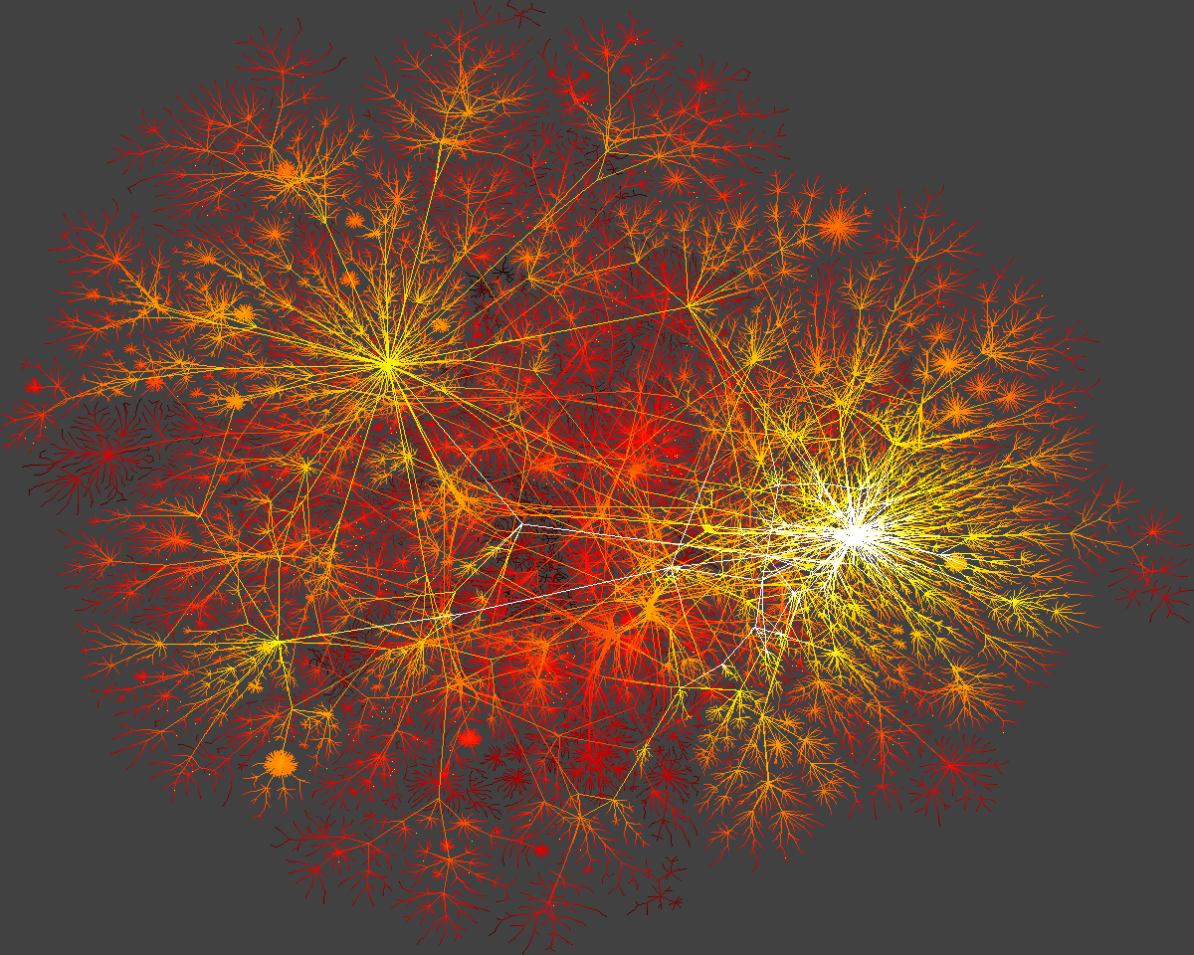
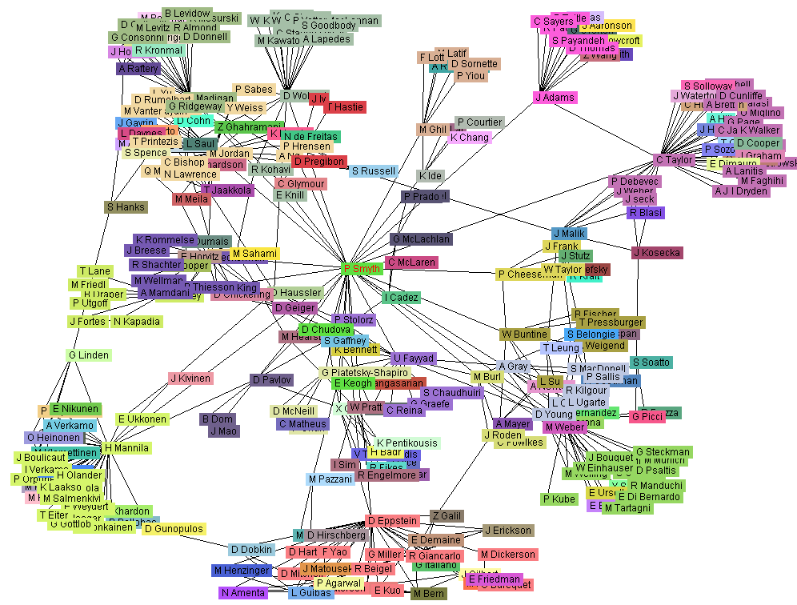
Graphs
Aspirin
Yeast protein interaction network
Internet
Co-author network

Slide 3
Graph Terminology
A graph is a non linear data structure that consists of a set of vertices and a set of edges between pairs of vertices.
Unlike a tree or binary tree, a graph does not have a root – no primary entry point.

Slide 4
Edges represent paths or connections between the vertices.
Any node can be connected to any other node by an edge/ends/end points/end vertices .
Can have any number of edges and nodes.
Example: the highway system connecting cities on a map

Slide 5
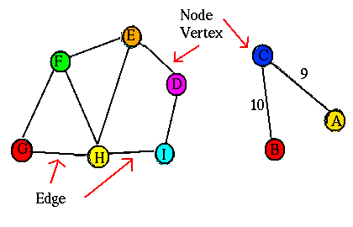

Slide 6
G is an ordered pair G: = (V,E) that is subject to
the following conditions:
• V is a set, whose elements are called vertices or nodes,
• E is a multiset of unordered pairs of vertices (not necessarily distinct), called edges or lines.

Slide 7
The order of a graph is | V |
➔ the number of vertices
A graph's size is | E |
➔ the number of edges
Degree of a vertex
➔ is the number of edges that connect to it where an edge that connects to the vertex at both ends (a loop) is counted twice.

Slide 8
Vertices adjacent to a given vertex are called its neighbors.
A path is a sequence of edges.
The edges in a graph may have values associated with them known as their weights
A graph with weighted edges is known as a weighted graph

Slide 9
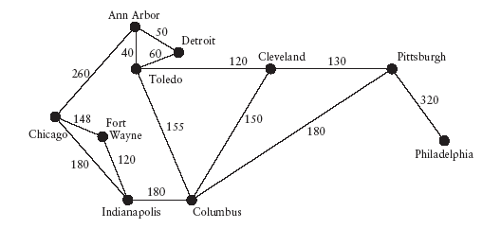

Slide 10
Connected graphs
  A graph is said to be connected if for every pair of its vertices u and v there is a path from u to v.
Connected graph
Non-Connected graph

Slide 11
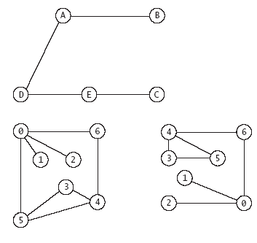
Visual Representation of Graphs
Vertices are represented as points or labeled circles and edges are represented as lines joining the vertices
The physical layout of the vertices and their labeling are not relevant.

Slide 12
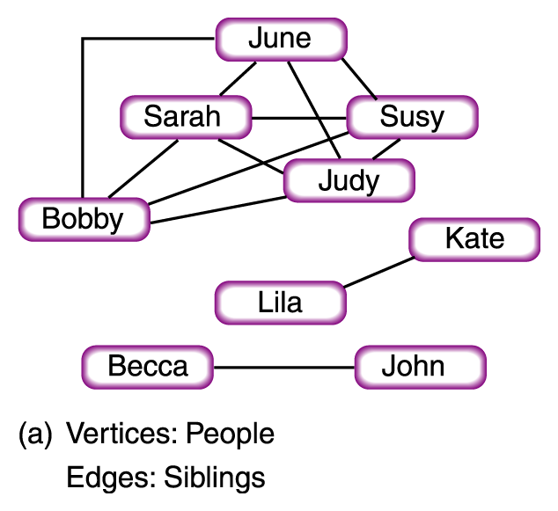

Slide 13
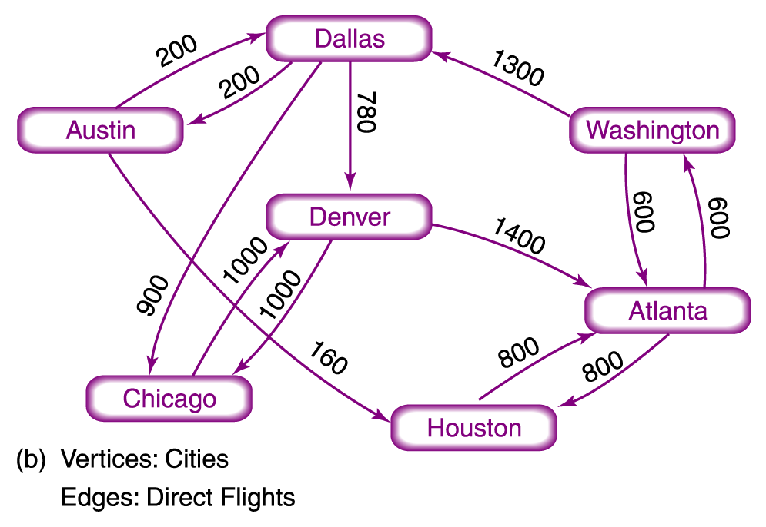

Slide 14
Types of Graphs

Slide 15
Directed and Undirected Graphs
Undirected graph A graph in which the edges have no direction
Directed graph (Digraph) A graph in which each edge is directed from one vertex to another (or the same) vertex
The edges of a graph are directed if the existence of an edge from A to B does not necessarily guarantee that there is a path in both directions.
tail
head

Slide 16
An arc e = (x,y) is considered to be directed from x to y;
y is called the head and x is called the tail of the arc;
y is said to be a direct successor of x
x is said to be a direct predecessor of y
The arc (y,x) is called the arc (x,y) inverted.

Slide 17
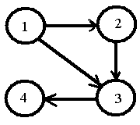
Example of Directed Graph
Example G = (V, E), V = {1, 2, 3, 4} and
E ={ (1,2), (2,3), (3,4), (1,3)}

Slide 18
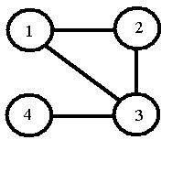
Example of Undirected Graph
Example G = (V, E), V = {1, 2, 3, 4} and
E = { {1,2}, {2,3}, {3,4}, {1,3}}

Slide 19
Finite Graph
A finite graph is a graph G = <V,E> such that V(G) and E(G) are finite sets.
Most commonly in graph theory it is implied that the discussed graphs are finite

Slide 20
Simple Graph
A simple graph is an undirected graph that has no self-loops and no more than one edge between any two different vertices.
In a simple graph the edges of the graph form a set (rather than a multiset) and each edge is a pair of distinct vertices.
In a simple graph with p vertices every vertex has a degree that is less than p.

Slide 21
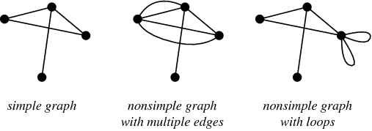

Slide 22
Regular Graph
A regular graph is a graph where each vertex has the same number of neighbors
i.e., every vertex has the same degree or valence.
A regular graph with vertices of degree k is called a k-regular graph or regular graph of degree k.

Slide 23
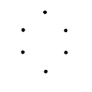

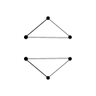
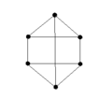
0 - regular graph
1 - regular graph
2 - regular graph
3 - regular graph

Slide 24
Weighted Graph
A graph is a weighted graph if a number (weight) is assigned to each edge.
Such weights might represent, for example, costs, lengths or capacities, etc. depending on the problem.

Slide 25
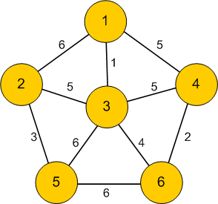
Weight of the graph is sum of the weights given to all edges.

Slide 26
Mixed Graphs
A mixed graph G is a graph in which some edges may be directed and some may be undirected.

Slide 27
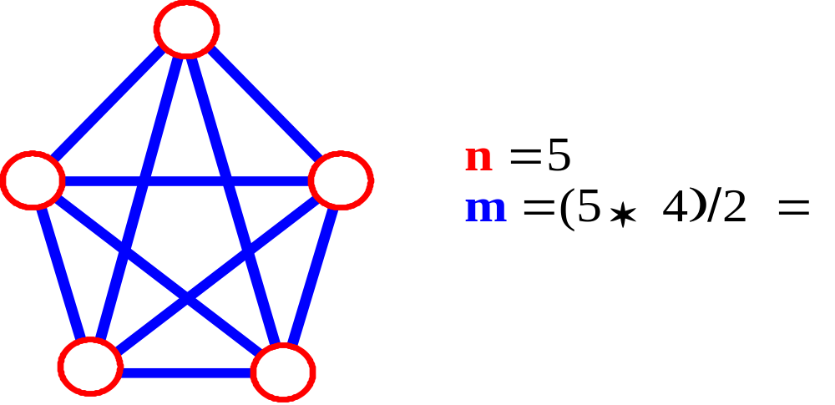
Complete Graph
A complete graph: one in which all pairs of vertices are adjacent.
Let n = #vertices, and m = #edges

Slide 28
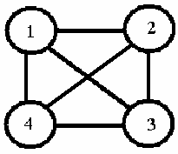
Example for Complete Graph
Example
E={1,2,3,4}
V={{1,2}, {1,3},{1,4},{2,3},{2,4},{3,4}}

Slide 29
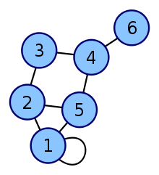
Loop
A loop is an edge (directed or undirected) which starts and ends on the same vertex; these may be permitted or not permitted according to the application.

Slide 30
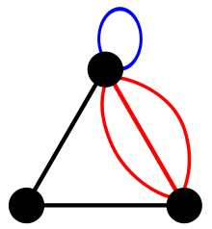
Multi Graph
The term "multi graph" is generally understood to mean that multiple edges (and sometimes loops) are allowed.
Where graphs are defined so as to allow loops and multiple edges.

Slide 31
Representing Graphs
Vertices can be represented by a vertex class (i.e.similar to node or link in LL).
Vertex objects can be placed in
  an array,
  list or
  other data structure.
Graphs can be represented using adjacency matrix or adjacency list.

Slide 32
Adjacency List
Vertices are labelled (or re-labelled) from 0 to |V(G)|-1.
Corresponding to each vertex is a list (either an array or linked list) of its neighbours.
a
b
a
b
d
c
b
a
c
c
d
c
d
a
b
d
a
c

Slide 33
0
A
1
4
0
1
2
3
4
1 2 4
B
E
2
1
3
C
D
2
3
Head nodes vertex links
0
•
3 •
1 •
2 NULL
0
1
•
2 •
0 •
3 NULL
1
2
2
•
3 •
0 •
1 NULL
3
3
•
2 •
1 •
0 NULL

Slide 34
0
1
2
3
4
5
6
7
1
2
0
4
0
3
2
1
5
0
3
1
2
3
6
5
7
4
6
5
7
6
0
0
1
2
1
1
0
2
2

Slide 35
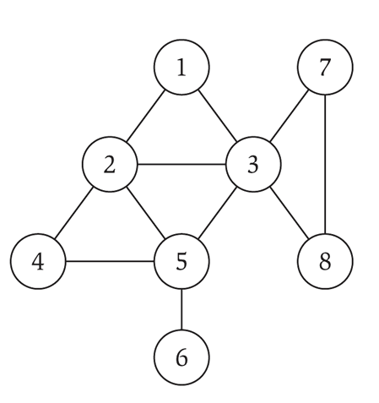
1
2
3
2
1
3
4
5
3
1
2
5
7
8
4
2
5
5
2
3
4
6
6
5
7
3
8
8
3
7

Slide 36
Adjacency Matrix
Vertices are labelled (or re-labelled) with integers from 0 to |V(G)|-1.
Uses a two-dimensional array to represent a graph.
For an unweighted graph, the entries can be Boolean values.
For a weighted graph, the matrix would contain the weights.

Slide 37
1
2
1 2 3 4
1 0 1 1 1
2 1 0 1 0
3 1 1 0 1
4 1 0 1 0
a
b
c
d
3
4
0
A
1
4
0 1 2 3 4
B
E
0
1
2
3
4
0 1 1 0 1
0 0 1 0 0
0 1 0 1 0
0 0 0 0 0
0 0 0 0 0
C
D
2
3

Slide 38
1 2 3 4 5 6 7 8
1 0 1 1 0 0 0 0 0
2 1 0 1 1 1 0 0 0
3 1 1 0 0 1 0 1 1
4 0 1 0 1 1 0 0 0
5 0 1 1 1 0 1 0 0
6 0 0 0 0 1 0 0 0
7 0 0 1 0 0 0 0 1
8 0 0 1 0 0 0 1 0

Slide 39
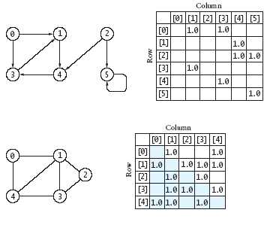

Slide 40
Graph Traversals
Most graph algorithms involve visiting each vertex in a systematic order
Most common traversal algorithms are the breadth first and depth first search.
  Depth first search
    Similar to the preorder traversal of a binary tree
  Breadth first search
    Similar to traversing a binary tree level by level

Slide 41
Breadth First Search
Expands the frontier between discovered and undiscovered vertices uniformly across the breadth of the frontier.
  A vertex is “discovered” the first time it is encountered during the search.
  A vertex is “finished” if all vertices adjacent to it have been discovered.
Computes the shortest distance (dist) from s to any reachable node.

Slide 42
Breadth-First Search
Steps:
-- start with visiting a starting vertex
-- visit the next unvisited adjacent vertex, mark it and insert it into the queue.
-- if there are no unvisited vertices, remove a vertex from the queue and make it the current vertex.
-- continue until you reach the end.
L₀
A
L₁
B
C
D
L₂
E
F

Slide 43
Colors the vertices to keep track of progress.
  White – Undiscovered.
  Gray – Discovered but not finished.
  Black – Finished.
    Colors are required only to reason about the algorithm. Can be implemented without colors.
2
3
3
2
3
1
2
S
S
1
2
S
1
2
3
3
2
Finished
Discovered
Undiscovered

Slide 44
Example (BFS)
r
s
t
u
∞
0
∞
∞
∞
∞
∞
∞
v
w
x
y
Q: s
0

Slide 45
Example (BFS)
r
s
t
u
1
0
∞
∞
∞
1
∞
∞
v
w
x
y
Q: w r
1 1

Slide 46
Example (BFS)
r
s
t
u
1
0
2
∞
∞
1
2
∞
v
w
x
y
Q: r t x
1 2 2

Slide 47
Example (BFS)
r
s
t
u
1
0
2
∞
2
1
2
∞
v
w
x
y
Q: t x v
2 2 2

Slide 48
Example (BFS)
r
s
t
u
1
0
2
3
2
1
2
∞
v
w
x
y
Q: x v u
2 2 3

Slide 49
Example (BFS)
r
s
t
u
1
0
2
3
2
1
2
3
v
w
x
y
Q: v u y
2 3 3

Slide 50
Example (BFS)
r
s
t
u
1
0
2
3
2
1
2
3
v
w
x
y
Q: u y
3 3

Slide 51
Example (BFS)
r
s
t
u
1
0
2
3
2
1
2
3
v
w
x
y
Q: y
3

Slide 52
Example (BFS)
r
s
t
u
1
0
2
3
2
1
2
3
v
w
x
y
Q: ∅

Slide 53
Example (BFS)
r
s
t
u
1
0
2
3
2
1
2
3
v
w
x
y
BF Tree

Slide 54
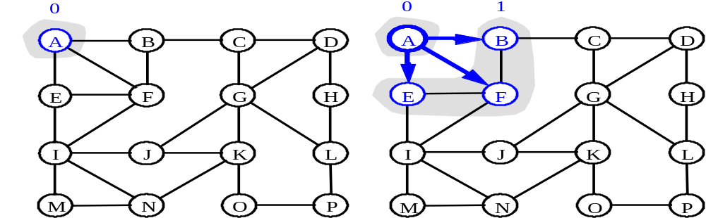
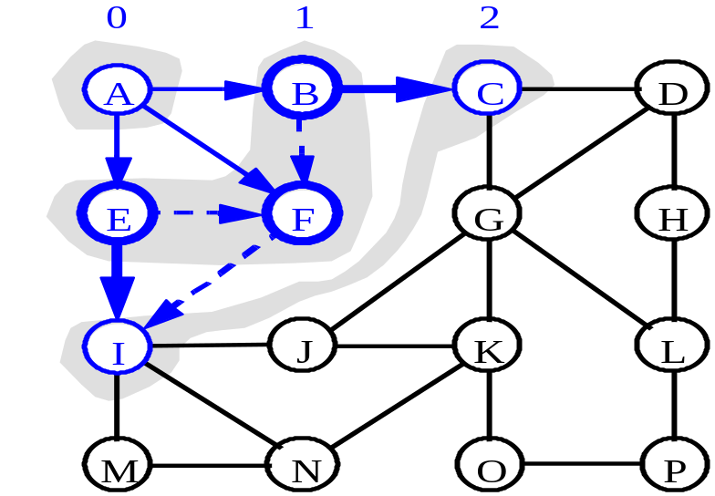
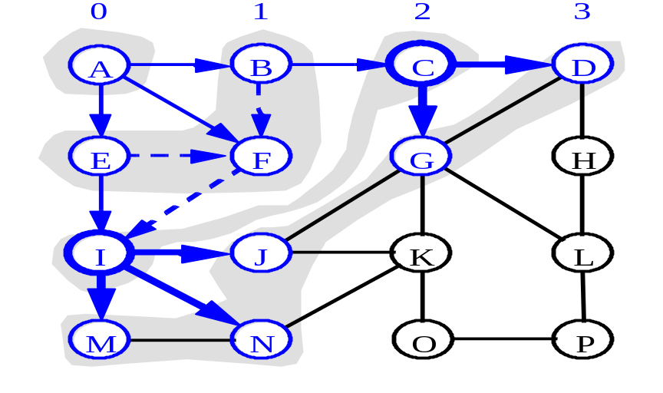
a)
b)
c)
d)

Slide 55
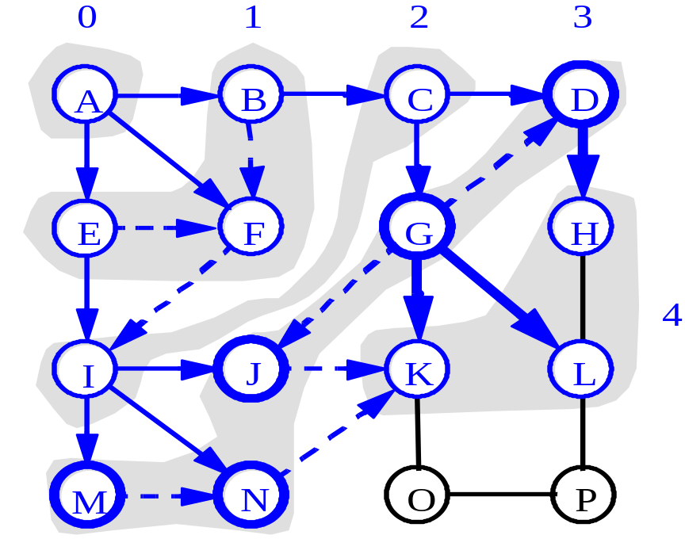
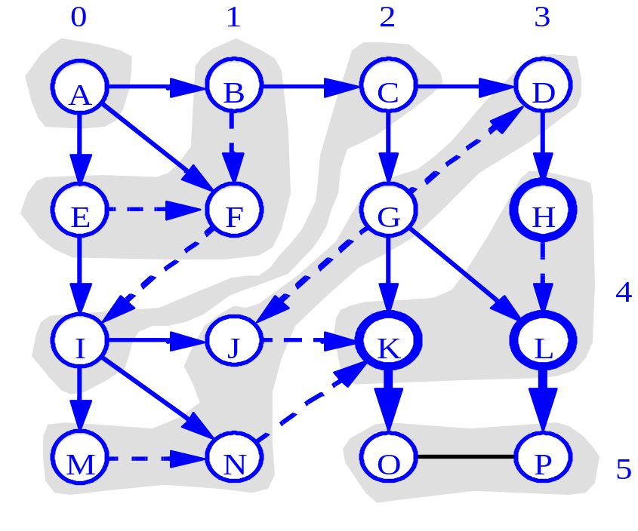

Slide 56
Each node can be added to the queue at most once (it needs to be white), and its adjacency list is searched only once. At most all adjacency lists are searched.
If graph is undirected each edge is reached twice, so loop repeated at most 2 times.
If graph is directed each edge is reached exactly once. So the loop repeated at most 1 time.

Slide 57
L₀
unexplored vertex
A
A
A
visited vertex
L₁
B
C
D
unexplored edge
discovery edge
E
F
cross edge
L₀
L₀
A
A
L₁
L₁
B
C
D
B
C
D
E
F
E
F

Slide 58
L₀
A
L₀
A
L₁
B
C
D
L₁
B
C
D
E
F
L₂
E
F
L₀
L₀
A
A
L₁
L₁
B
C
D
B
C
D
L₂
L₂
E
F
E
F

Slide 59
L₀
A
L₀
A
L₁
B
C
D
B
C
D
L₂
L₁
E
F
L₂
E
F
L₀
A
L₁
B
C
D
L₂
E
F

Slide 60
Depth First Search
Can be implemented with a stack to remember where it should go when it reaches a dead end.
DFS goes far way from the starting point as quickly as possible and returns only if it reaches a dead end.
Used in simulations of games

Slide 61
Steps:
  -- start with a vertex
  -- visit it
  -- push it on a stack and mark it
  -- go to any vertex adjacent to it that hasn’t yet been visited
  -- if there are no unvisited nodes, pop a vertex off the stack till you come across a vertex that has unvisited adjacent vertices

Slide 62
Example (DFS)
u
v
w
1/
x
y
z

Slide 63
Example (DFS)
u
v
w
1/
2/
x
y
z

Slide 64
Example (DFS)
u
v
w
1/
2/
3/
x
y
z

Slide 65
Example (DFS)
u
v
w
1/
2/
4/
3/
x
y
z

Slide 66
Example (DFS)
u
v
w
1/
2/
B
4/
3/
x
y
z

Slide 67
Example (DFS)
u
v
w
1/
2/
B
4/5
3/
x
y
z

Slide 68
Example (DFS)
u
v
w
1/
2/
B
4/5
3/6
x
y
z

Slide 69
Example (DFS)
u
v
w
1/
2/7
B
4/5
3/6
x
y
z

Slide 70
Example (DFS)
u
v
w
1/
2/7
F
B
4/5
3/6
x
y
z

Slide 71
Example (DFS)
u
v
w
1/8
2/7
F
B
4/5
3/6
x
y
z

Slide 72
Example (DFS)
u
v
w
1/8
2/7
9/
F
B
4/5
3/6
x
y
z

Slide 73
Example (DFS)
u
v
w
1/8
2/7
9/
F
B
C
4/5
3/6
x
y
z

Slide 74
Example (DFS)
u
v
w
1/8
2/7
9/
F
B
C
4/5
3/6
10/
x
y
z

Slide 75
Example (DFS)
u
v
w
1/8
2/7
9/
F
B
C
4/5
3/6
10/
B
x
y
z

Slide 76
Example (DFS)
u
v
w
1/8
2/7
9/
F
B
C
4/5
3/6
10/11
B
x
y
z

Slide 77
Example (DFS)
u
v
w
1/8
2/7
9/12
F
B
C
4/5
3/6
10/11
B
x
y
z

Slide 78
A
unexplored vertex
A
A
visited vertex
B
D
E
unexplored edge
discovery edge
C
back edge
A
A
B
D
E
B
D
E
C
C

Slide 79
A
A
B
D
E
B
D
E
C
C
A
A
B
D
E
B
D
E
C
C

Slide 80
In this version all nodes are discovered even if the graph is directed, or undirected and not connected
The algorithm saves:
– A depth first forest of the edges used to
discover new nodes.
– Timestamps for the first time a node u is
discovered d[u] and the time when the node is
fully explored f[u]

Slide 81
BreadtFirstSearch() first tries to mark all neighbors of a vertex v before proceeding other vertices, whereas
DFS() picks one neighbor of a v and then proceeds to a neighbor of this neighbor before processing any other neighbors of v.

Slide 82
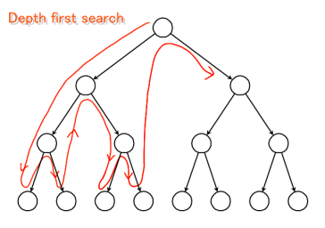
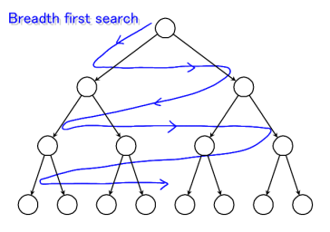
Graph Traversals

Slide 83
DFS vs. BFS
Back edge (v,w)
  w is an ancestor of v in the tree of discovery edges
Cross edge (v,w)
  w is in the same level as v or in the next level in the tree of discovery edges
L₀
A
A
L₁
B
C
D
B
C
D
L₂
E
F
E
F
DFS
BFS

Slide 84
DFS vs. BFS
Applications | DFS | BFS
Spanning forest, connected components, paths, cycles | √ | √
Shortest paths |  | √
Biconnected components | √
L₀
A
A
L₁
B
C
D
B
C
D
L₂
E
F
E
F
DFS
BFS

Slide 85
F
B
A
start
DFS Process
E
destination
G
D
C
C
D
B
B
B
Call DFS on D
A
A
A
A
Return to call on B
DFS on A
DFS on B
DFS on C
G
D
found destination - done!
Path is implicitly stored in DFS recursion
Path is: A, B, D, G
B
Call DFS on G
A

Slide 86
F
B
A
start
BFS Process
E
G
D
C
destination
rear
front
rear
front
rear
front
A
B
D
C
Initial call to BFS on A
Add A to queue
Dequeue B
Add C, D
Dequeue A
Add B
rear
front
rear
front
D
G
Dequeue C
Nothing to add
Dequeue D
Add G
Path must be stored separately

Slide 87
Shortest Path
Given a weighted graph and two vertices u and v, we want to find a path of minimum total weight between u and v.
  Length of a path is the sum of the weights of its edges.
Applications
  Internet packet routing
  Flight reservations
  Driving directions

Slide 88
Example:
  Shortest path between Providence and Honolulu
849
PVD
1843
ORD
142
SFO
802
LGA
1743
1205
337
1387
HNL
2555
1099
LAX
1233
DFW
1120
MIA

Slide 89
The weight of path p = < v0, v1,….vk> is the sum of the weights of its constituent edges.
Given a weighted graph and two vertices u and v, we want to find a path of minimum total weight between u and v.
– Length of a path is the sum of the weights of its edges.

Slide 90
We will focus on Single source shortest paths problem: given a graph G = (V,E), we want to find a shortest path from a given source vertex s V to each vertex v V.
Shortest Path Properties
Property 1: A sub path of a shortest path is itself a shortest path.
Property 2: There is a tree of shortest paths from a start vertex to all the other vertices.

Slide 91
The shortest path algorithms use the technique of relaxation.
For each vertex v, an attribute d[v] is maintained which is an upper bound on the weight of a shortest path from source s to v.
d[v] – shortest path estimate
A relaxation step may decrease the value of the shortest path estimate d[v].

Slide 92
Our algorithms are based on applying repeatedly one of two types of relaxation operations:
Edge relaxation: Test whether traveling along a given edge gives a new shortest path to its destination vertex.
Path relaxation: Test whether traveling through a given vertex gives a new shortest path connecting two other given vertices.

Slide 93
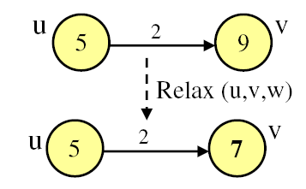
Relaxation
Relaxation of an edge (u,v) with
weight w(u,v) = 2
d[v] > d[u] + w(u,v)
d[v] is changed by relaxation

Slide 94
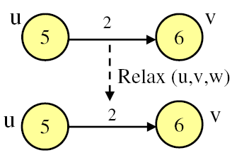
d[v] < d[u] + w(u,v)
d[v] is unchanged by relaxation

Slide 95
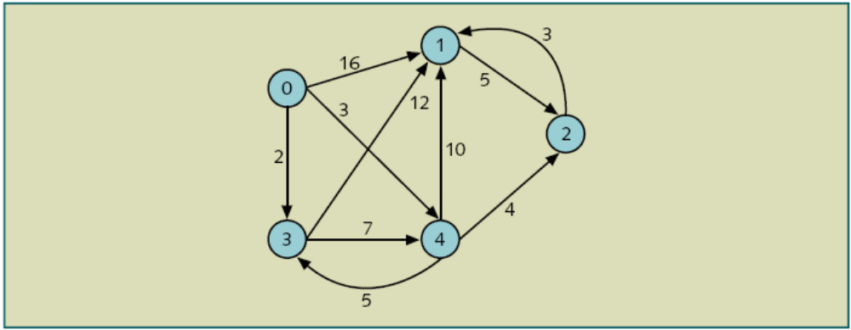
Find the shortest path

Slide 96
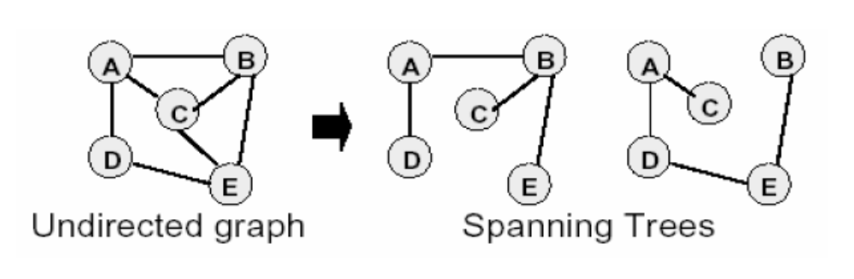
Spanning Tree
A spanning tree of a graph is a sub graph that is a tree containing all the vertices.

Slide 97
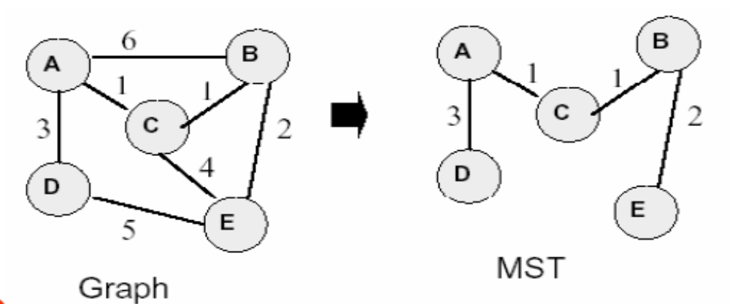
Minimum Spanning Tree
The spanning tree among all spanning trees with the lowest total edge weight.

Slide 98
Algorithms Using Weighted Graphs
A minimum spanning tree is a subset of the edges of a graph such that there is only one edge between each vertex, and all of the vertices are connected
The cost of a spanning tree is the sum of the weights of the edges
We want to find the minimum spanning tree or the spanning tree with the smallest cost
Solution formulated by R.C. Prim or Dijkstra’s algorithm

Slide 99
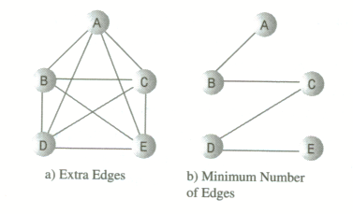

Slide 100
Problem: Laying Telephone Wire
Central office

Slide 101
Wiring: Naïve Approach
Central office
Expensive!

Slide 102
Wiring: Better Approach
Central office
Minimize the total length of wire connecting the customers

Slide 103
How Can We Generate a MST?
9
b
9
b
a
2
6
a
2
6
d
d
4
5
4
5
5
4
5
4
5
e
5
e
c
c

Slide 104
Two well-known algorithms involve with MST concept
  Prim’s algorithm
  Kruskal’s algorithm

Slide 105
Prim’s Algorithm
Initialization
a. Pick a vertex r to be the root
b. Set D(r) = 0, parent(r) = null
c. For all vertices v ∈ V, v ≠ r, set D(v) = ∞
d. Insert all vertices into priority queue P,
using distances as the keys
9
Vertex Parent
e -
b
a
2
6
e
a
b
c
d
d
4
5
0
∞
∞
∞
∞
5
4
5
e
c

Slide 106
Prim’s algorithm
Vertex Parent
e -
b -
c -
d -
e
d
b
c
a
0
∞
∞
∞
∞
9
b
a
2
6
d
4
5
Vertex Parent
e -
b e
c e
d e
5
4
d
b
c
a
5
e
c
4
5
5
∞
The MST initially consists of the vertex e, and we update
the distances and parent for its adjacent vertices

Slide 107
Prim’s algorithm
Vertex Parent
e -
b e
c e
d e
d
b
c
a
4
5
5
∞
9
b
a
2
6
d
4
5
5
4
Vertex Parent
e -
b e
c d
d e
a d
5
e
c
a
c
b
2
4
5

Slide 108
Prim’s algorithm
Vertex Parent
e -
b e
c d
d e
a d
a
c
b
2
4
5
9
b
a
2
6
d
4
5
5
4
5
e
c
Vertex Parent
e -
b e
c d
d e
a d
c
b
4
5

Slide 109
Prim’s algorithm
Vertex Parent
e -
b e
c d
d e
a d
c
b
9
b
4
5
a
2
6
d
4
5
5
4
5
e
Vertex Parent
e -
b e
c d
d e
a d
c
b
5

Slide 110
Prim’s algorithm
Vertex Parent
e -
b e
c d
d e
a d
b
5
9
b
a
2
6
d
4
5
5
4
5
e
c
Vertex Parent
e -
b e
c d
d e
a d
The final minimum spanning tree

Slide 111
Kruskal Example
2704
867
BOS
849
PVD
ORD
187
740
144
1846
621
JFK
184
1258
802
SFO
BWI
1391
1464
337
1090
DFW
946
LAX
1235
1121
MIA
2342

Slide 112
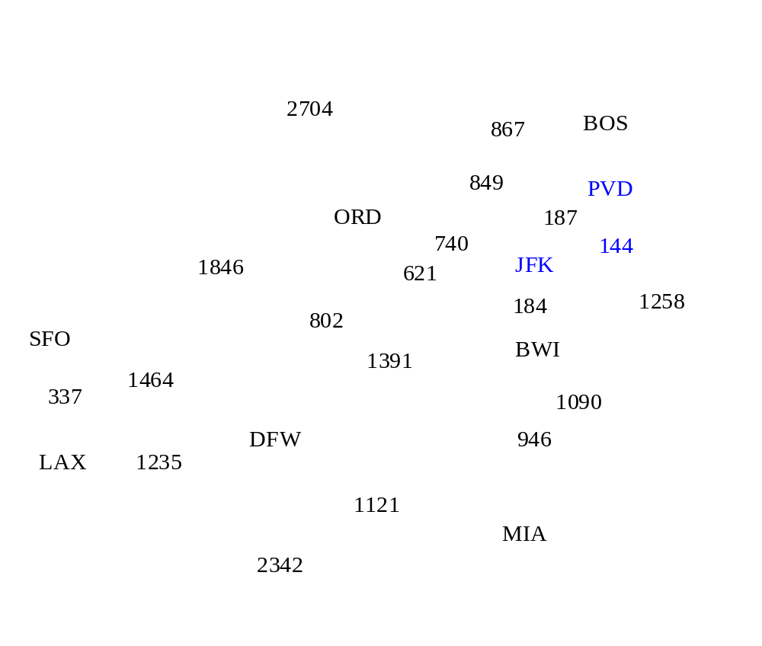

Slide 113
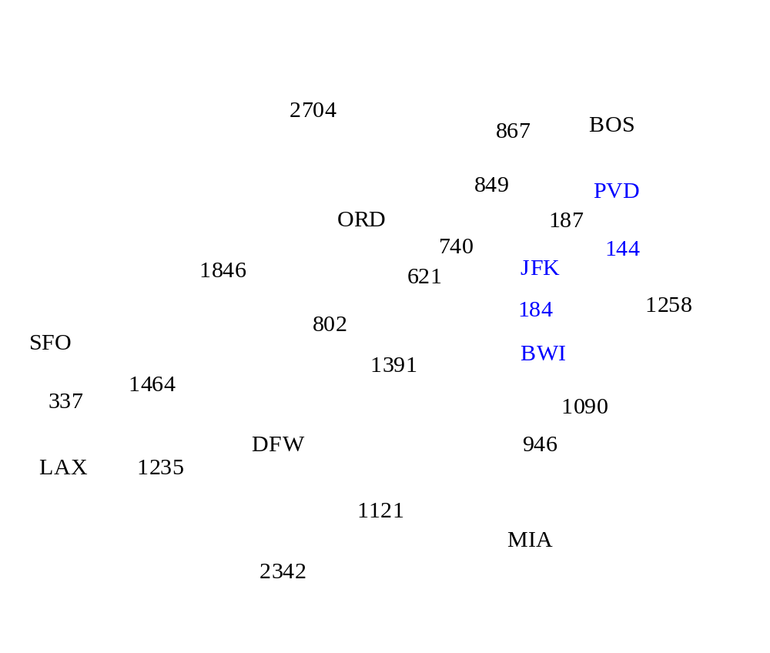

Slide 114
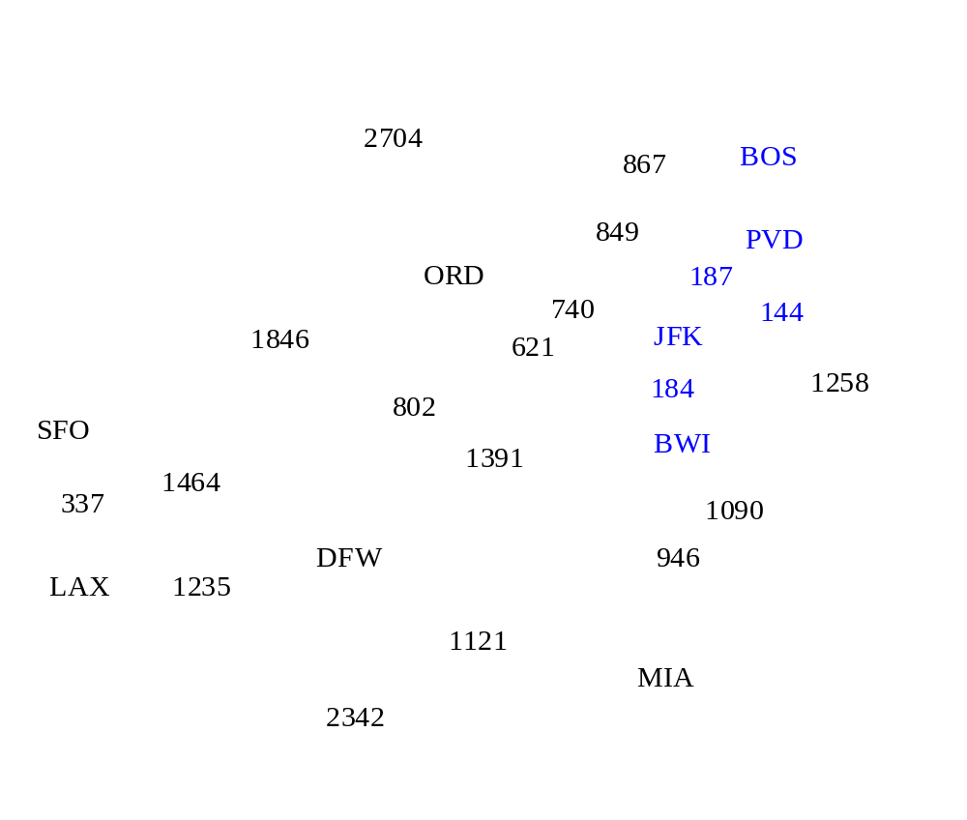

Slide 115
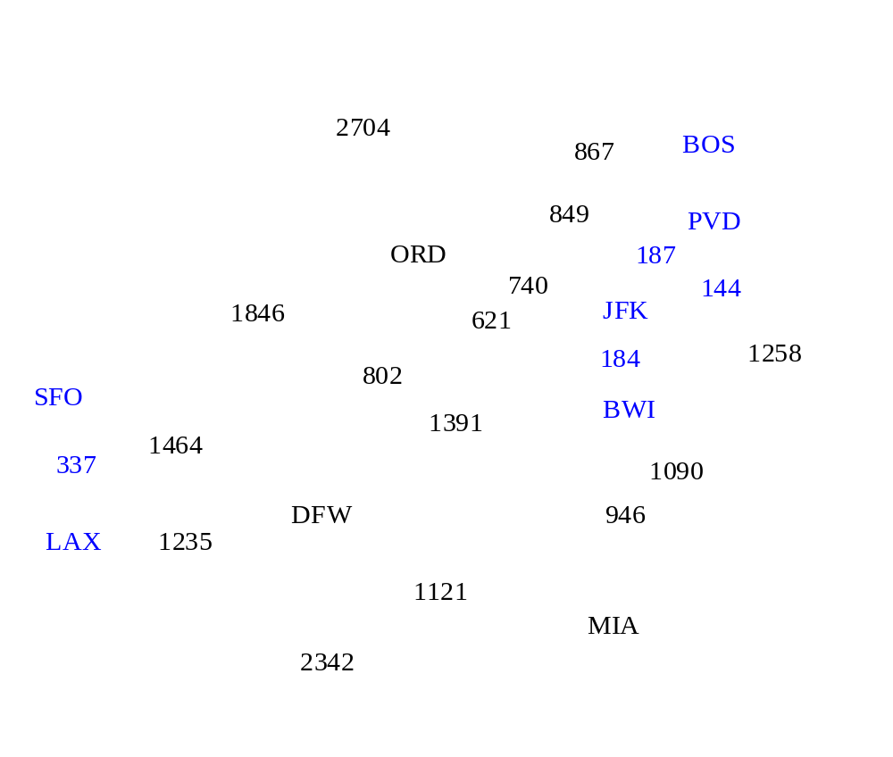

Slide 116
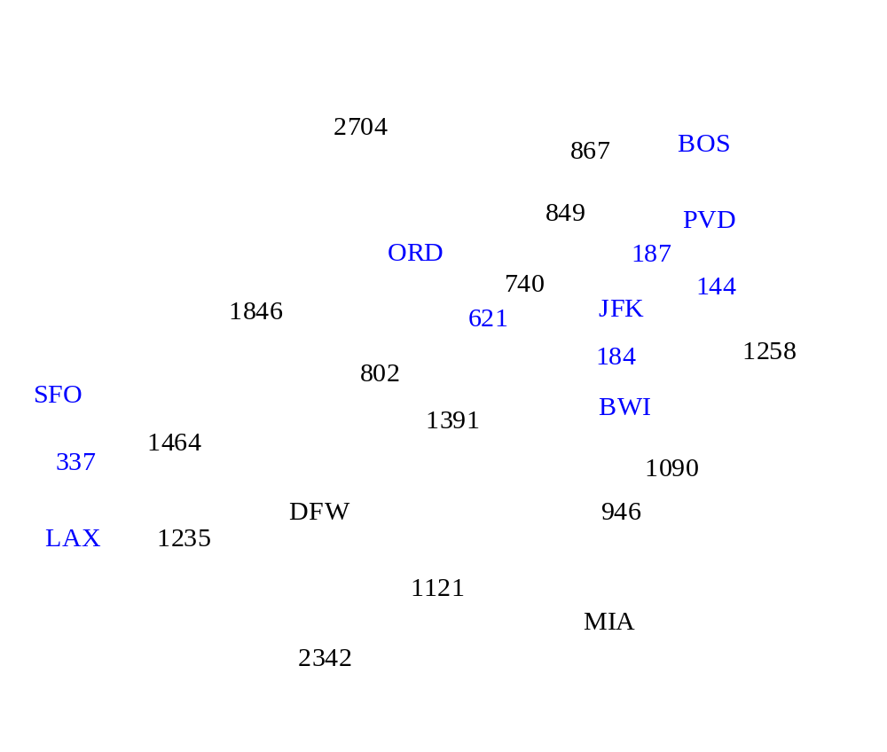

Slide 117
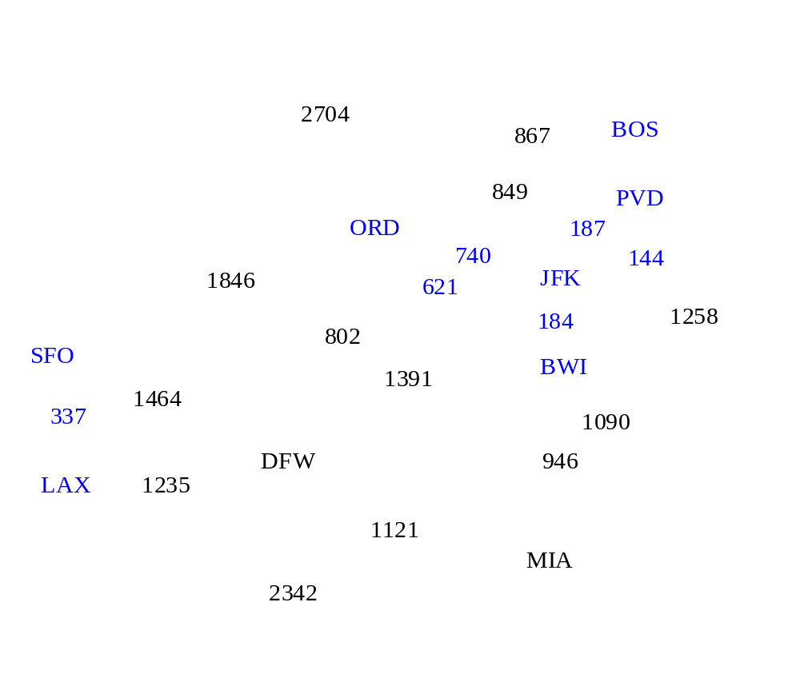

Slide 118
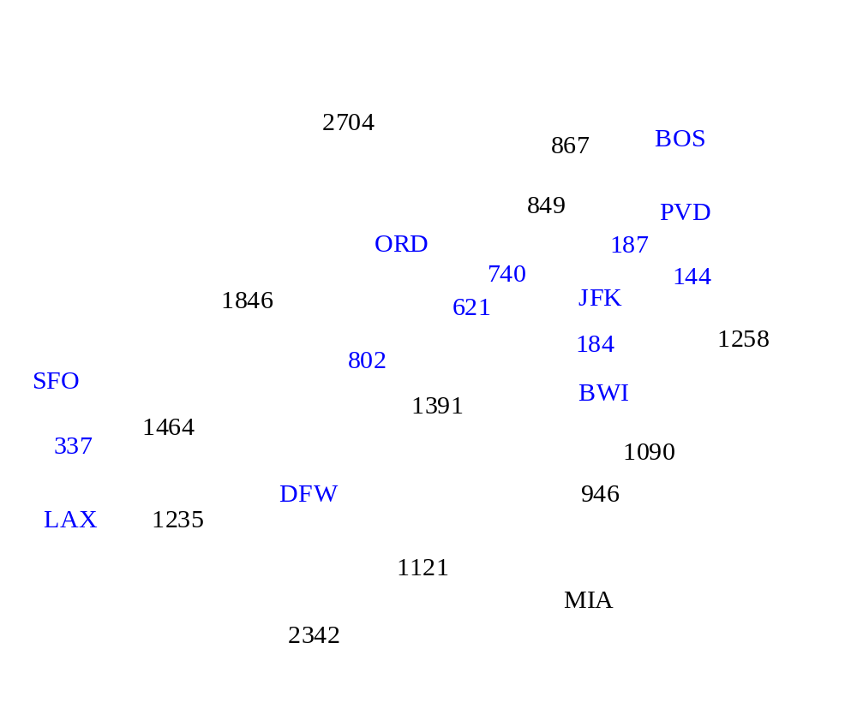

Slide 119
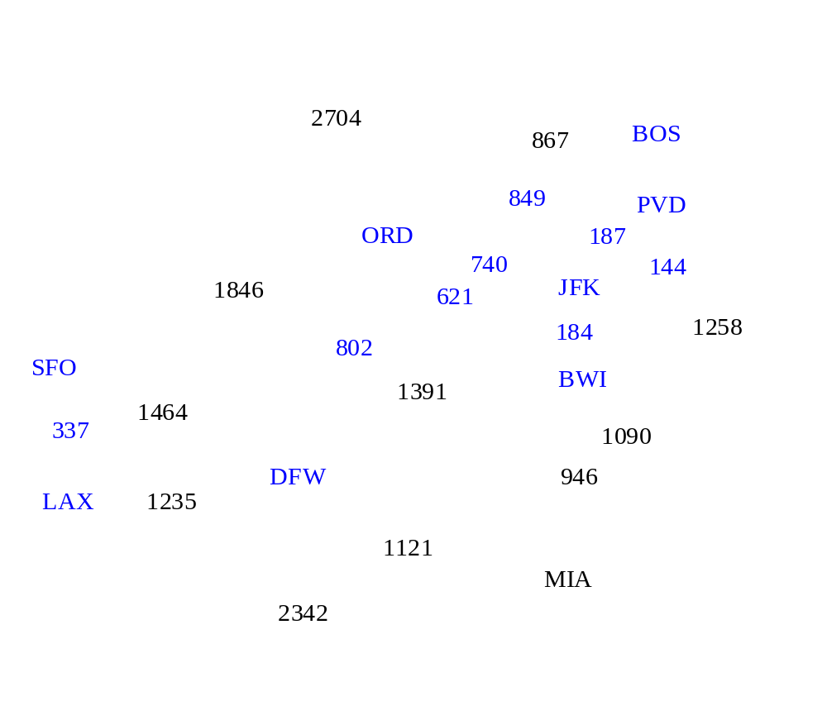

Slide 120
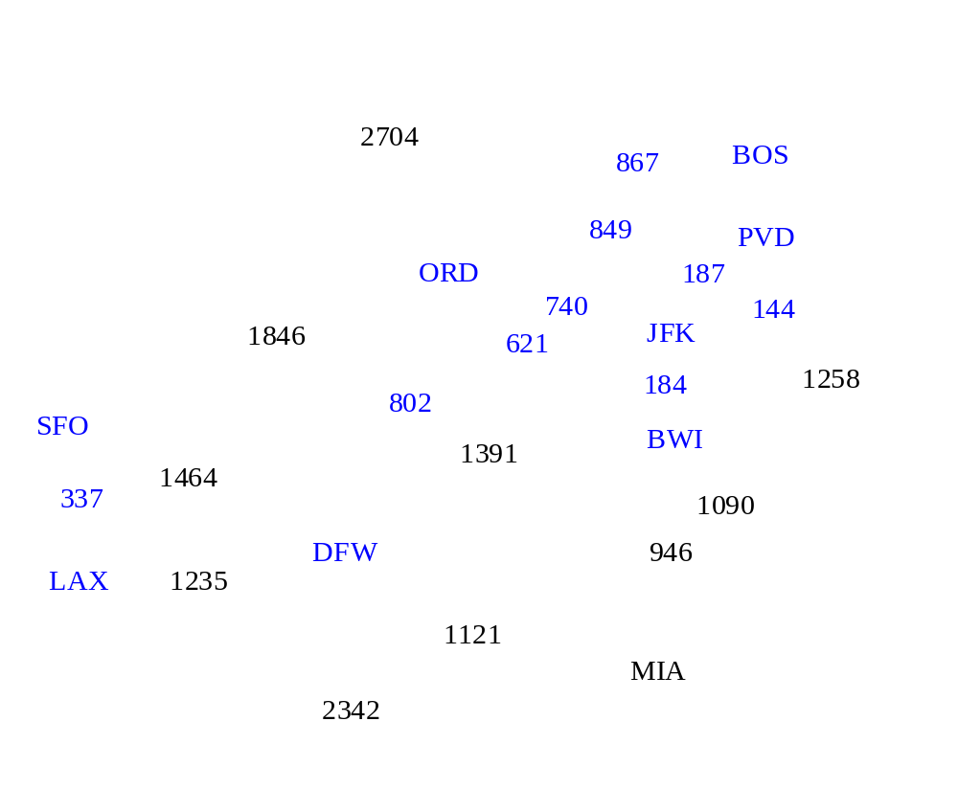

Slide 121


Slide 122
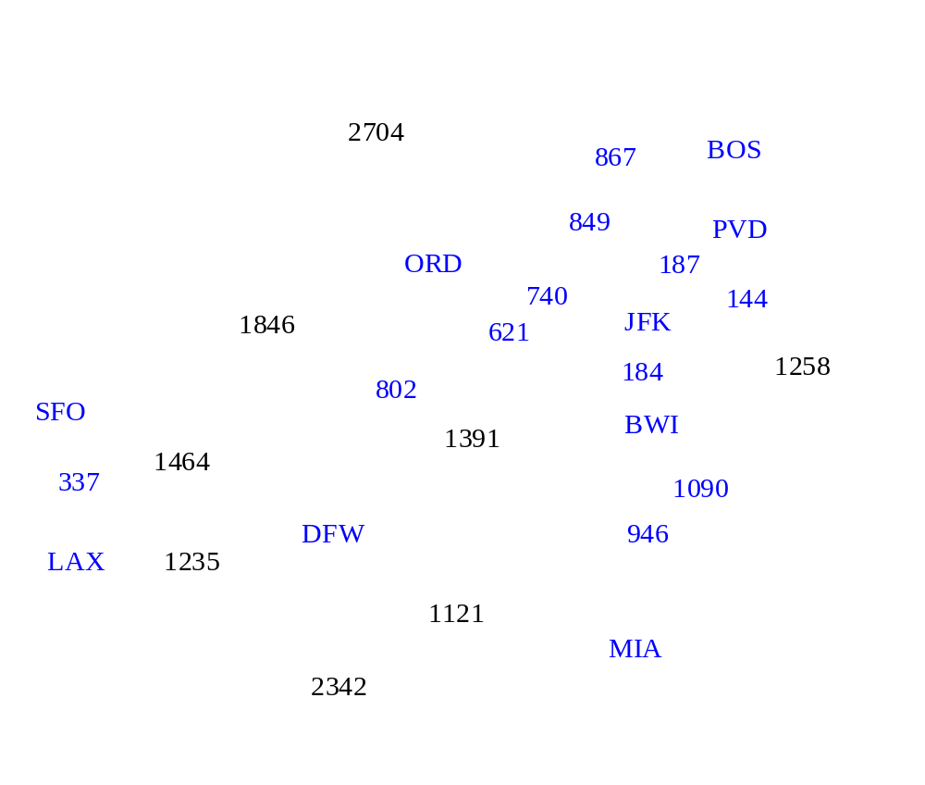

Slide 123


Slide 124

2704
867
BOS
849
PVD
ORD
187
740
144
1846
621
JFK
184
1258
802
SFO
BWI
1391
1464
337
1090
DFW
946
LAX
1235
1121
MIA
2342

Slide 125
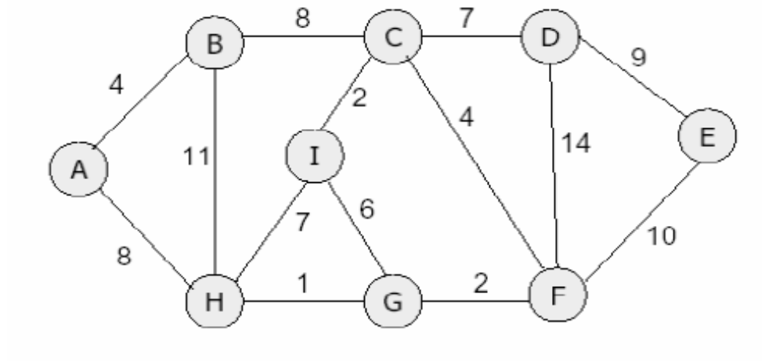
Example 01: Find the minimum spanning tree.

Slide 126
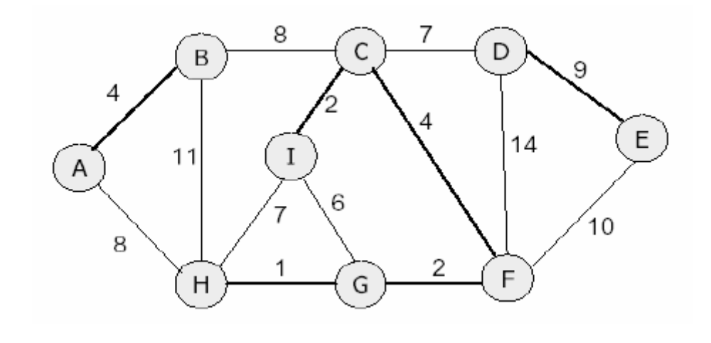
Answer

Slide 127
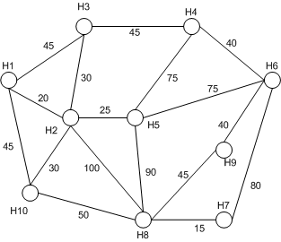
Example 02: Find the minimum spanning tree.

Slide 128
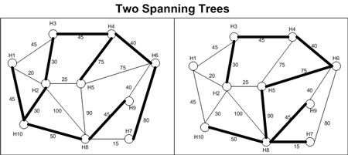
Answer

Slide 129
Topological Sort
Graphs are sometimes used to represent “before and after” relationships.
For example, you need to think through a design for a program before you start coding.
These two steps can be represented as vertices, and the relationship between them as a directed edge from the first to the second.

Slide 130
A topological sort is an ordering of the vertices of a directed acyclic graph given by the following definition:
Definition (Topological Sort) Consider a directed acyclic graph . A topological sort of the vertices of G is a sequence in which each element of appears exactly once. For every pair of distinct vertices and in the sequence S, if is an edge in G, i.e., , then i<j.

Slide 131
The simplest topological sort algorithm is to repeatedly remove vertices with indegree of 0 from the graph.
The edges belonging to the vertex are also removed, reducing the in-degree of adjacent vertices.
This is done until the graph is empty, or until no vertex without incoming edges exists, in which case the sort fails.

Slide 132
Topological Sorting Example

Slide 133
Topological Sorting Example
9

Slide 134
Topological Sorting Example
8
9

Slide 135
Topological Sorting Example
7
8
9

Slide 136
Topological Sorting Example
6
7
8
9

Slide 137
Topological Sorting Example
6
5
7
8
9

Slide 138
Topological Sorting Example
4
6
5
7
8
9

Slide 139
Topological Sorting Example
3
4
6
5
7
8
9

Slide 140
Topological Sorting Example
2
3
4
6
5
7
8
9

Slide 141
Topological Sorting Example
2
1
3
4
6
5
7
8
9

Slide 142
Topological Sort: DFS
C
G
A
B
D
E
F
H

Slide 143
Topological Sort: DFS
C
dfs(A)
G
A
B
D
E
F
H

Slide 144
Topological Sort: DFS
C
dfs(A)
dfs(D)
G
A
B
D
E
F
H

Slide 145
Topological Sort: DFS
C
dfs(A)
dfs(D)
dfs(E)
G
A
B
D
E
F
H

Slide 146
Topological Sort: DFS
C
dfs(A)
dfs(D)
dfs(E)
dfs(F)
G
A
B
D
E
F
H

Slide 147
Topological Sort: DFS
C
dfs(A)
dfs(D)
dfs(E)
dfs(F)
dfs(H)
G
A
B
D
E
F
H

Slide 148
Topological Sort: DFS
C
dfs(A)
dfs(D)
dfs(E)
dfs(F)
G
A
B
D
E
F
H
7

Slide 149
Topological Sort: DFS
C
dfs(A)
dfs(D)
dfs(E)
G
A
B
D
E
F
6
H
7

Slide 150
Topological Sort: DFS
C
dfs(A)
dfs(D)
G
A
B
D
E
5
F
6
H
7

Slide 151
Topological Sort: DFS
C
dfs(A)
dfs(D)
G
A
B
D
E
5
F
6
H
7

Slide 152
Topological Sort: DFS
C
dfs(A)
G
A
B
D
E
4
5
F
6
H
7

Slide 153
Topological Sort: DFS
C
dfs(A)
G
A
B
D
E
4
5
F
6
H
7

Slide 154
Topological Sort: DFS
C
G
A
3
B
D
E
4
5
F
6
H
7

Slide 155
Topological Sort: DFS
C
dfs(B)
G
A
3
B
D
E
4
5
F
6
H
7

Slide 156
Topological Sort: DFS
C
dfs(B)
G
A
3
B
D
E
4
5
F
6
H
7

Slide 157
Topological Sort: DFS
C
G
A
3
B
2
D
E
4
5
F
6
H
7

Slide 158
Topological Sort: DFS
C
dfs(C)
G
A
3
B
2
D
E
4
5
F
6
H
7

Slide 159
Topological Sort: DFS
C
dfs(C)
G
A
3
B
2
D
E
4
5
F
6
H
7

Slide 160
Topological Sort: DFS
C
dfs(C)
G
A
3
B
2
D
E
4
5
F
6
H
7

Slide 161
Topological Sort: DFS
C
dfs(C)
G
A
3
B
2
D
E
4
5
F
6
H
7

Slide 162
Topological Sort: DFS
C
dfs(C)
dfs(G)
G
A
3
B
2
D
E
4
5
F
6
H
7

Slide 163
Topological Sort: DFS
C
dfs(C)
G
1
A
3
B
2
D
E
4
5
F
6
H
7

Slide 164
Topological Sort: DFS
0
C
G
1
A
3
B
2
D
E
4
5
F
6
H
7

Slide 165
Topological Sort: DFS
0
C
G
1
A
3
B
2
D
E
4
5
F
6
H
7
Topological order: C G B A D E F H

Slide 166
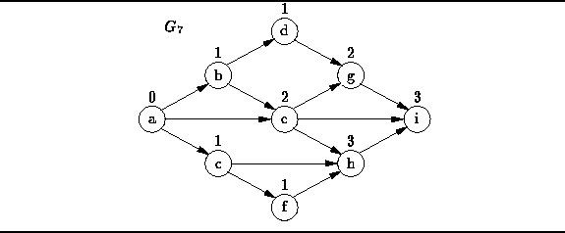

Topological sort is not unique.
For example, the following are also valid topological sorts of the graph :

Slide 167
Networks
Networks can be used to represent the transportation of some commodity through a system of delivery channels.
There are sources (x) and sinks (y).
  Source (s) - node with only outflows
  Sink (t) - node with only inflows
The network is a directed graph, where each arc a is associated with a capacity, c(a).

Slide 168


Slide 169
Flow of a Network
A flow of a network [f(a)] indicates how much of a channel’s capacity [c(a)] is being used.
The amount of flow on an edge cannot exceed the capacity of the edge.
i.e. 0 ≤ f (a) ≤ c(a)

Slide 170
A flow must satisfy the restriction that the amount of flow into a node equals the amount of flow out of it, except when it is a source, which has more outgoing flow, or sink, which has more incoming flow.
For a vertex v, the flow into and out of the vertex is denoted by f−(v) and f+(v) respectively.
For intermediate vertices (not sources or sinks) the flow in is the same as the flow out. This is called the conservation condition.

Slide 171
This type of network can be used to model :
traffic in a road system
fluids in pipes
currents in an electrical circuit
or anything similar in which something travels through a network of nodes.

Slide 172
Resultant Flow
For some set of vertices V, the resultant flow out of S is given by f+(V) − f−(V).

Slide 173
Cuts
a cut is a partition of the vertices of a graph into two disjoint subsets.
The cut-set of the cut is the set of edges whose end points are in different subsets of the partition.
Edges are said to be crossing the cut if they are in its cut-set.

Slide 174
The size of a cut C = (S,T) is the number of edges in the cut-set.
If the edges are weighted, the value of the cut is the sum of the weights.
There are different ways to apply cuts.
For example: minimum cut, maximum cut, sparse cut

Slide 175

Minimum Cut
A cut is minimum if the size of the cut is not larger than the size of any other cut.
The illustration here shows a minimum cut: the size of this cut is 2, and there is no cut of size 1.

Slide 176

Maximum Cut
A cut is maximum if the size of the cut is not smaller than the size of any other cut.
The illustration here shows a maximum cut: the size of the cut is |E| − 1 = 5, and there is no cut of size |E|.

Slide 177
Max-flow Min-cut Theorem
The max-flow min-cut theorem states that in a flow network, the maximum amount of flow passing from the source to the sink is equal to the minimum capacity that needs to be removed from the network so that no flow can pass from the source to the sink.

Slide 178
Maximum Flow
A
60
B
50
90
S
30
40
T
10
110
D
100
C
30

Slide 179
Maximum Flow
A
60
B
50
90
S
30
40
T
10
110
D
100
C
30

Slide 180
Maximum Flow
A
60
B
50
90
S
30
40
T
10
110
D
100
C
30

Slide 181
Maximum Flow
A
50/60
B
50/50
50/90
S
30
40
T
10
110
D
100
C
30

Slide 182
Maximum Flow
A
50/60
B
50/50
50/90
S
30
40
T
10
110
D
100
C
30

Slide 183
Maximum Flow
A
50/60
B
50/50
80/90
S
30/30
40
T
10
110
D
30/100
C
30

Slide 184
Maximum Flow
A
50/60
B
50/50
80/90
S
30/30
40
T
10
110
D
30/100
C
30

Slide 185
Maximum Flow
A
50/60
B
50/50
80/90
S
30/30
40
T
10
110
D
30/100
C
30

Slide 186
Maximum Flow
A
50/60
B
50/50
80/90
S
30/30
40
T
10
30/110
D
60/100
C
30/30

Slide 187
Maximum Flow
A
50/60
B
50/50
80/90
S
30/30
40
T
10
30/110
D
60/100
C
30/30

Slide 188
Maximum Flow
A
60/60
B
50/50
90/90
S
30/30
10/40
T
10
30/110
D
70/100
C
30/30

Slide 189
Maximum Flow
A
60/60
B
50/50
90/90
S
30/30
10/40
T
10
30/110
D
70/100
C
30/30

Slide 190
Max-flow Min-cut
A
60/60
B
50/50
90/90
S
30/30
10/40
T
10
30/110
D
70/100
C
30/30
A cut of a network graph

Slide 191
The cut consists of the subsets S={s,a,c} and T={b,d,t}.
The cut edges are drawn thick. The cut is an s-t-cut.
The value of the cut is 60+30+30=120.
It is also a minimum cut (with respect to the source s and the sink t), because there is a flow from s to t with value 120 in this network.

